Slide 1
Online schooling with part time job facility

Slide 2
Objective:
To create a web application for online studies which is simplifies the students to manage their daily academic routine and also to integrate it with a rich job portal which is managed by the institution that enables the students to work even when they studying and hence gain experience and money in order to get placed in well reputed company.

Slide 3
Targets of the project
Students
Teachers
Companies
Institution managements

Slide 4
Requirements
Landing page:
There should be a plain landing page with minimalist design.
Only need two button- i.e. Sign Up and Login
Some contents of our web app

Slide 5
Login Page:
There should be Username, Password, User type and a submit button
Direct us to the “my profile” page.

Slide 6
Sign Up Page:
Contains fields for first name, last name, dob, username, password, gender, mobile number, address, locale, district, state.
Direct to the “login” page.

Slide 7
My profile Page:
Shows the details of the currently logged in user.

Slide 8
Time table Page:
Shows the time table for students and teachers
Students won’t be able to change the time table but the teachers can.

Slide 9
Classwork Page:
All the works assigned to the students will be shown here.
There will be slot for the students to upload their works.
The work’s details like assigned time, work done time, etc will be recorded and notified.

Slide 10
Job portal:
Shows all available jobs/internships.
Have a biodata file in this page which each student can submit for applying for the job.

Slide 11
All the pages have the nav bar to each of the pages except to login and sign up.
There should be contact info at the bottom of each page.

Slide 12
Database design:
User table:
Fields | Data Types | Constraints
Usr_id | Varchar(10) | Primary
First Name | Varchar(30) | Not null
Last Name | Varchar(30) | Not null
Email | Varchar(30) | Unique
Password | Varchar(30) | Not null
Mobile no | Int(50) | Unique
Address | Varchar(30) | Not null
Dob | Date | Not null
Locale | Varchar(30) | Not null
District | Varchar(30) | Not null
gender | Varchar(10) | Not null
Usr_typ | Varchar(10) | Not null

Slide 13
Admin table:
Fields | Data type | Constraints
Admin_id | Varchar(10) | Foreign key(usr_id)
Desingnation | Varchar(30) | Not null

Slide 14
Student table:
Fields | Data type | Constraints
Std_id | Varchar(10) | Foreign key(usr_id)
Course | Varchar(30) | Not null
semester | Int(10) | Not null

Slide 15
Teacher table:
Fields | Data type | Constraints
Teacher_id | Varchar(10) | Foreign key(usr_id)
Subject | Varchar(30) | Not null

Slide 16
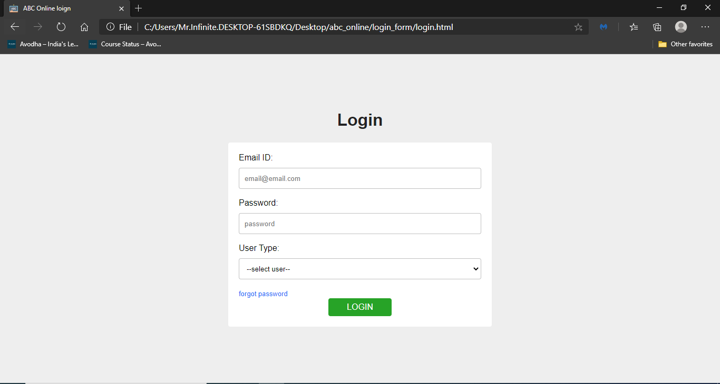

Slide 17
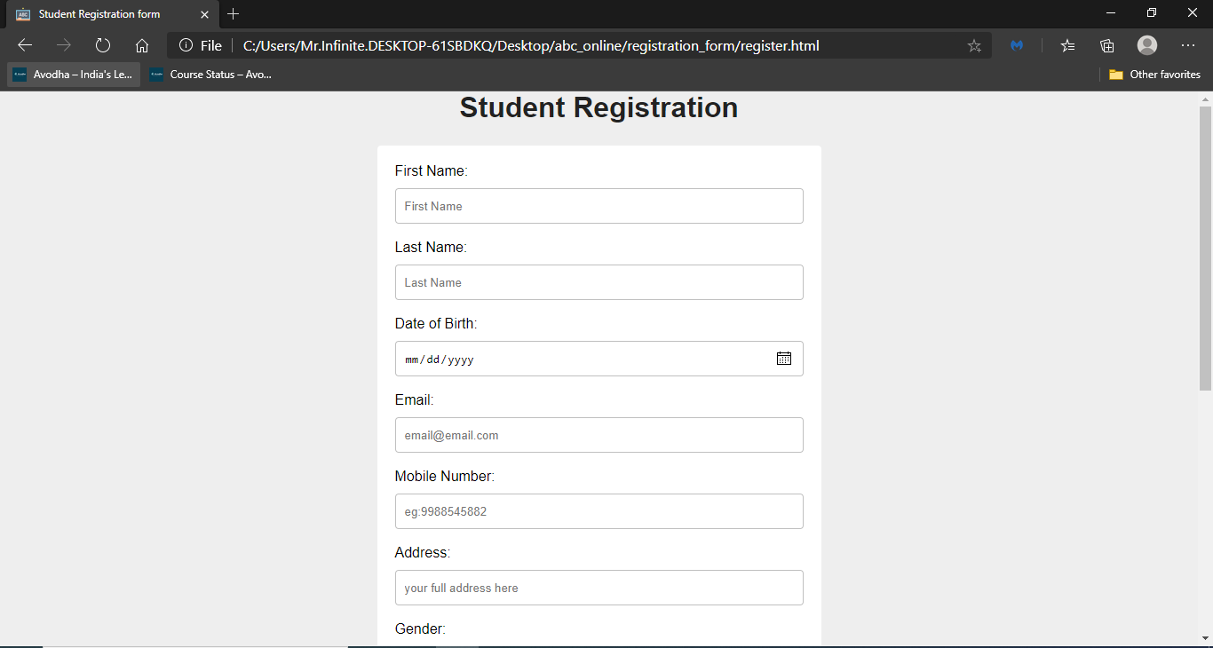

Slide 18
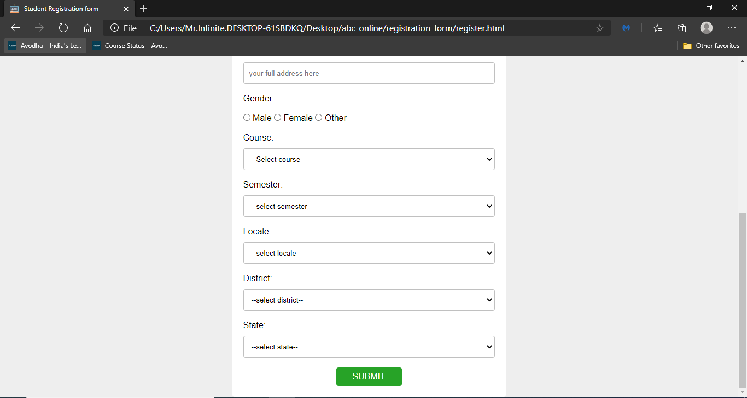

Slide 19
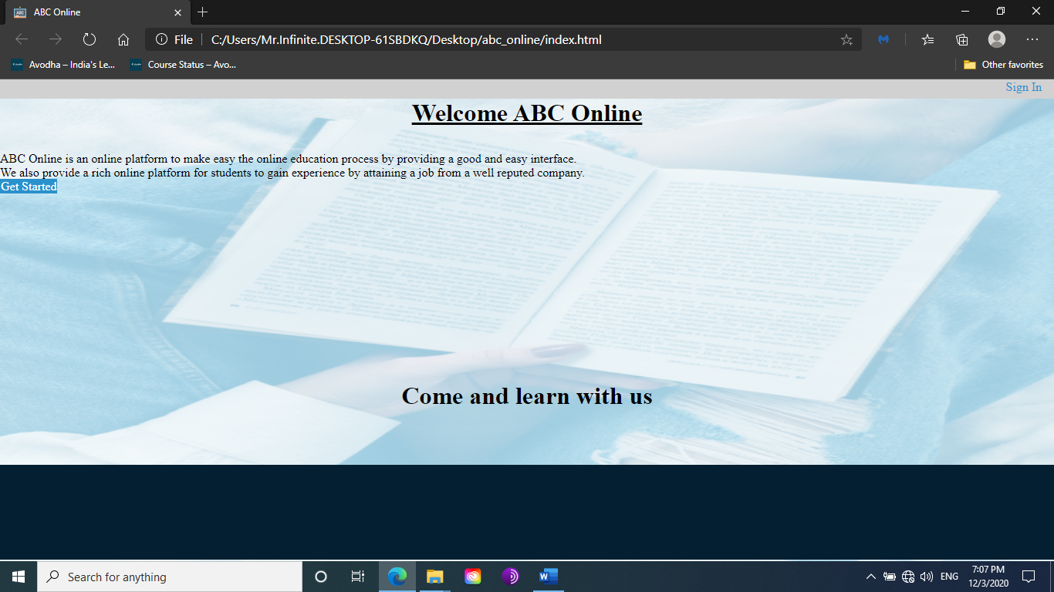

Slide 20
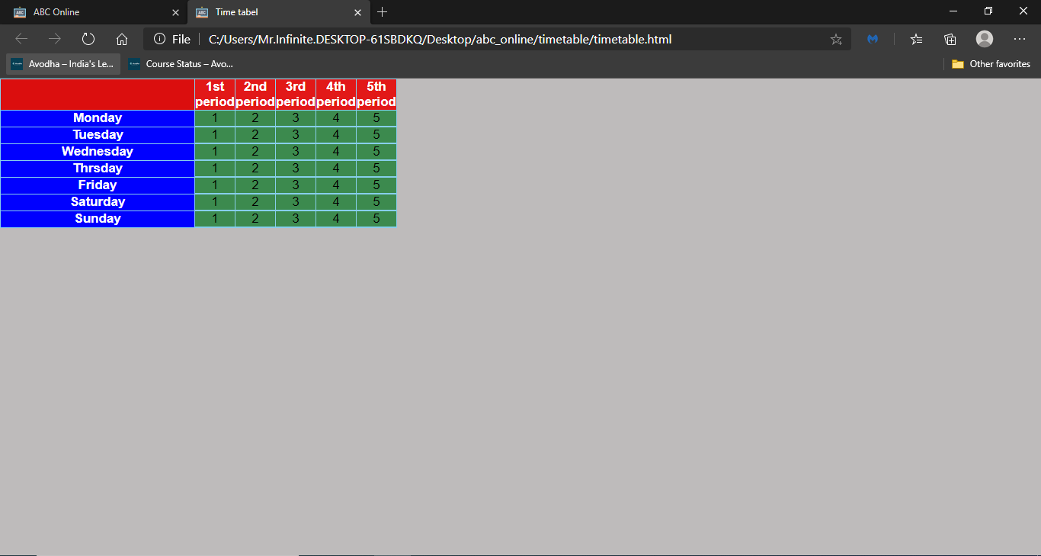

Slide 21
Thank you

